Slide 1
Using Op Amps as Comparators
by James Bryant
View the notes as well as the slides
of this PowerPoint presentation
Notes:
THIS is the notes section.

Slide 2
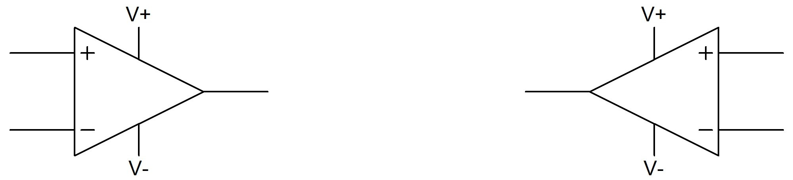
Using Op Amps as Comparators
Diagrams of op amps & comparators
look very similar
But a comparator gives a logic output indicating the relative potentials on its two inputs
An op amp amplifies the differential voltage
between its two inputs – and is designed always
to be used in closed-loop applications
Notes:
A comparator is a device with two input terminals, inverting and non-inverting, and an output which swings from rail to rail. So is an op amp.
A comparator has low offset, high gain and high common-mode rejection. So does an op amp.
So what is the difference? A comparator has a logic output that indicates which of the two inputs is at a higher potential. Its output is intended always to be at one rail or the other – or making a rapid transition between the two.
An op amp has an analog output which is not normally close to the supply rails, but is somewhere between them. It is designed to be used in closed-loop applications with feedback from its output to its inverting input. But the outputs of most modern op amps can swing close to their supply rails – so why not use them as comparators?
They have high gain, low offset and high common-mode rejection, and they usually have lower bias current – and are cheaper - than comparators. In addition they are often available in packages containing two or four op amps – if you need three op amps and a comparator it seems pointless to buy a quad op amp, not use one of them, and then buy a separate comparator.

Slide 3
Using Op Amps as Comparators
When considering using
an op amp as a comparator
remember Mr. Punch’s
advice
to those about to marry
DON’T!
The rest of this presentation consists of advice for those who have not taken this advice
Notes:
The best advice on using an op amp as comparator is very simple – don’t!
Comparators are designed to work open-loop, they are designed to drive logic circuits, and they are designed to work at high speed, even when over-driven.
Op amps are designed for none of these. They are intended to work closed-loop, to drive simple resistive or reactive loads, and should never be over-driven to saturation.
BUT
It is tempting to use op amps as comparators for a number of reasons. The remainder of this lecture summarizes the reasons, and warns of possible unexpected consequences of using an op amp as a comparator.

Slide 4
Using Op Amps as comparators
Why use an op amp as a comparator?
Convenience
(use the “spare” device in a quad)
Economy
Low I_{b}
Low V_{os}
Notes:
There are several reasons to use op amps as comparators. Some are technical, one is purely economic.
Op amps are manufactured as single devices, but also as duals and quads, two or four op amps on a single chip. These duals and quads are cheaper than two or four separate op amps – and occupy less board space, saving yet more money. It is good economics to use the spare op amp in a quad as a comparator rather than buying an additional comparator. But it may be bad engineering.
Comparators are designed for clean fast switching and, as a result, often have worse dc parameters than many op amps. So it may be convenient to use an op amp as a comparator in application requiring low Vos, low Ib, and wide CMR. It is never worthwhile to use an op amp as a comparator if high speed is important.

Slide 5
Using Op Amps as comparators
Why NOT use an op amp as a comparator?
Speed
(saturation means that op amps are slower)
Inconvenient input structures
Inconvenient logic structures
Stability / hysteresis
Notes:
There are several reasons not to use op amps as comparators.
First and foremost is speed, but there are also output levels, stability (and hysteresis) and a number of possible effects of input structures. We shall consider these in turn.

Slide 6
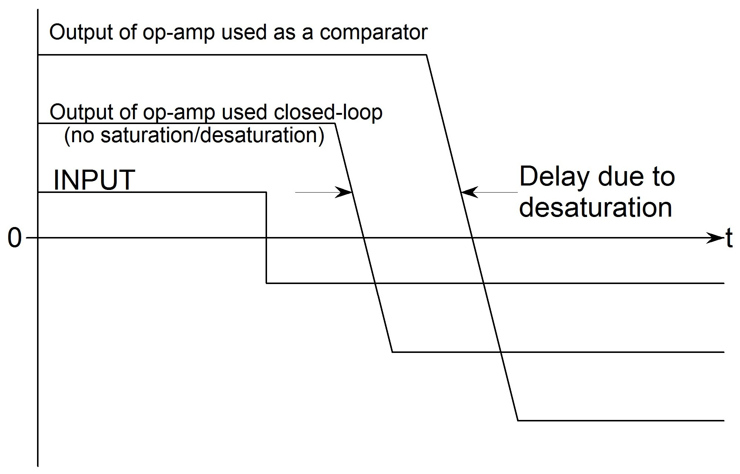
Using Op Amps as Comparators
SATURATION makes an op amp used as a comparator
slower than the same amplifier used closed-loop
Notes:
Most comparators are quite fast and some are very fast indeed – but so are some op amps. Why must we expect low speed when using an op amp as a comparator?
A comparator is designed to be used with large differential input voltages, whereas op amps normally operate with their input voltages minimized by negative feedback. When an op amp is over-driven, sometimes by only a few millivolts, some of its stages may saturate. If this occurs the device will take a comparatively long time to come out of saturation, and will, therefore, be much slower than if it were to be used unsaturated.

Slide 7
Using Op Amps as Comparators
DESATURATION is slow – and is rarely characterized on the data sheet
Testing for yourself is unreliable since batch-batch variations may be large
Notes:
The desaturation time of an over-driven op amp is likely to be considerably longer than its normal group delay (effectively the time a signal takes from input to output) and will often depend on the amount of overdrive.
Since few op amps are characterized for their desaturation times after differing levels of overdrive the user will find it necessary to determine, by experiment, the delays likely to result from the levels of overdrive expected in a particular application. The value used in design calculations should be at least be twice the worst value seen in any tests, since the samples tested may not be representative.

Slide 8
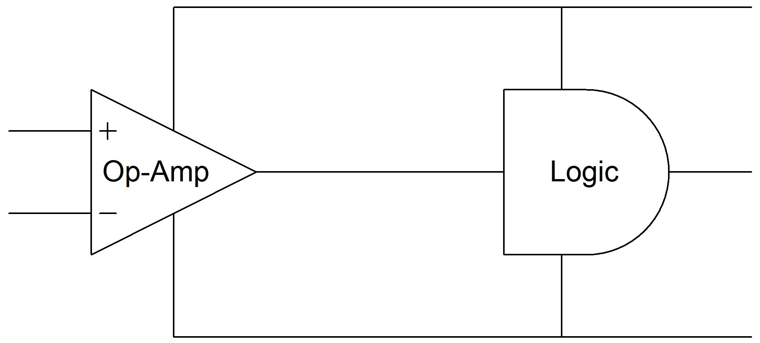
Using Op Amps as Comparators
V_{dd}
V_{ss}
A rail-to-rail op amp will drive CMOS or TTL logic using the same supply.
If the devices have different supplies interface circuitry is necessary.
Notes:
The output of a purpose-built comparator is designed to drive a particular logic family or families. Often there is a separate supply for the output stage to ensure that the logic levels are correct.
A modern op amp usually has rail-to-rail output – that is its maximum positive level is close to the positive supply and the minimum negative level is close to the negative supply. (Older designs used structures which had headroom of over 1.5 volts to both supplies.)
If logic and op amp share the same supply a rail-rail op amp will drive CMOS and TTL logic families quite successfully, but if the op amp and logic have different supplies then additional interface circuitry will be necessary between them. Note that this applies to an op amp with ±5 V supplies which must drive logic with +5 V supply – the logic is liable to be damaged if –5 V is applied to it.

Slide 9
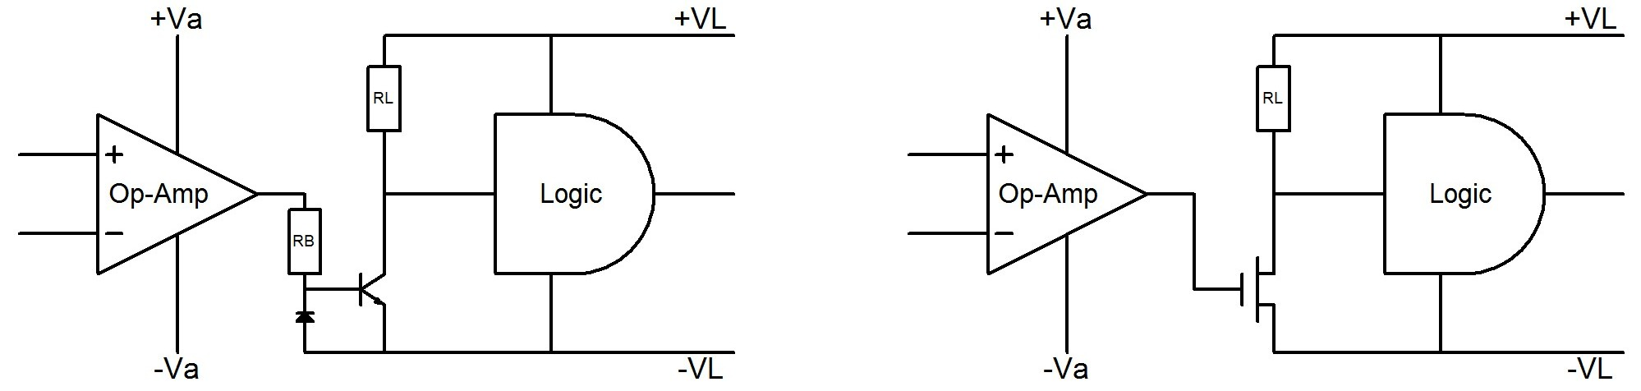
Using Op Amps as Comparators
The simplest interfaces between comparators and logic using different supplies are inverters using
a single transistor or MOSFET
Notes:
The simplest interface circuits are inverters. They may be built with NPN transistors, but these draw base current and N-channel MOSFET transistors are more convenient.
R_{B} sets the transistor base current and RL sets the collector/drain current. The lower their value the faster the inverter, but the more power it consumes. Values of a few kilohms are usually used. The N-channel MOS device should have a low gate threshold voltage (<2 V) and a gate-source breakdown voltage greater than the maximum output voltages of the op amp. ±25 V is usually sufficient.
Even though the op amp and the logic use different supplies they must be related to each other. The op amp positive supply +Va must be more positive than the logic negative supply –VL by at least 3 V so that there is enough voltage to turn on the transistor or the MOSFET gate, and the op amp negative supply must not be positive relative to the logic negative supply, although it may be connected to it. One must, of course, observe the absolute maximum ratings of all the devices used.

Slide 10
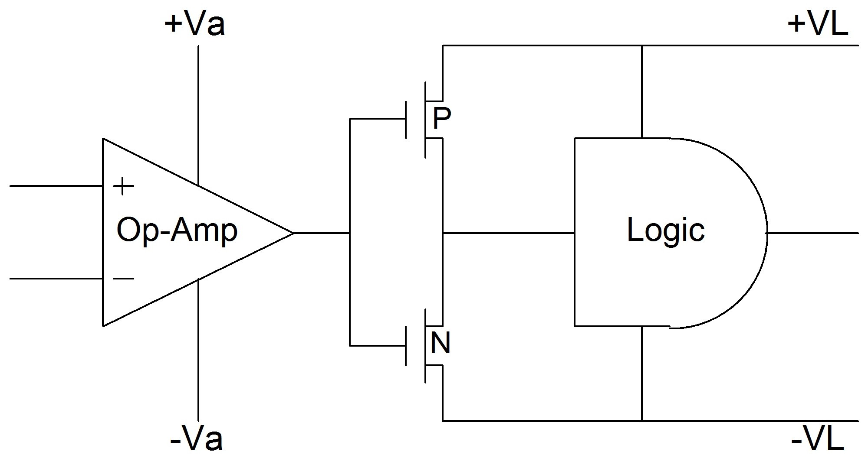
Using Op Amps as Comparators
An inverter using complementary MOSFETs
(P-channel and N-channel) draws no static current
Notes:
A complementary MOS inverter can be built with a P-channel and an N-channel MOSFET. This has the advantage of drawing no standby current, but it does have a relatively large current spike during switching when both devices are, briefly, turned on together.
With this arrangement the op amp positive supply +Va must be equal to or greater than the logic positive supply +VL, and the op amp negative supply must be equal to or less than the logic negative supply.

Slide 11
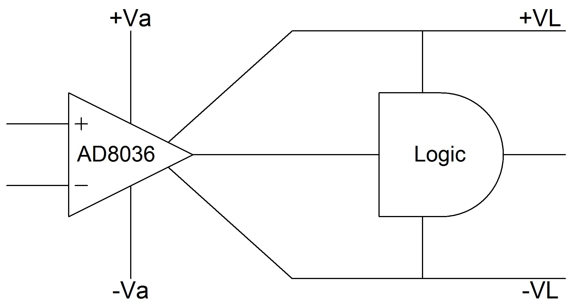
Using Op Amps as Comparators
A clamp amplifier such as the AD8036 can have its
output swing limited to the logic supplies without
the use of any additional components
Notes:
Another way of ensuring the correct logic interface levels is to use a clamp amplifier such as the AD8036. A clamp amplifier has positive and negative reference terminals and its output is clamped to within 30 mV of the reference voltages if it attempts to go above or below the positive and negative limits.
So if the positive and negative logic supplies are connected to the reference inputs (and the amplifier supplies are outside the logic supplies) the amplifier output will safely drive the logic.

Slide 12
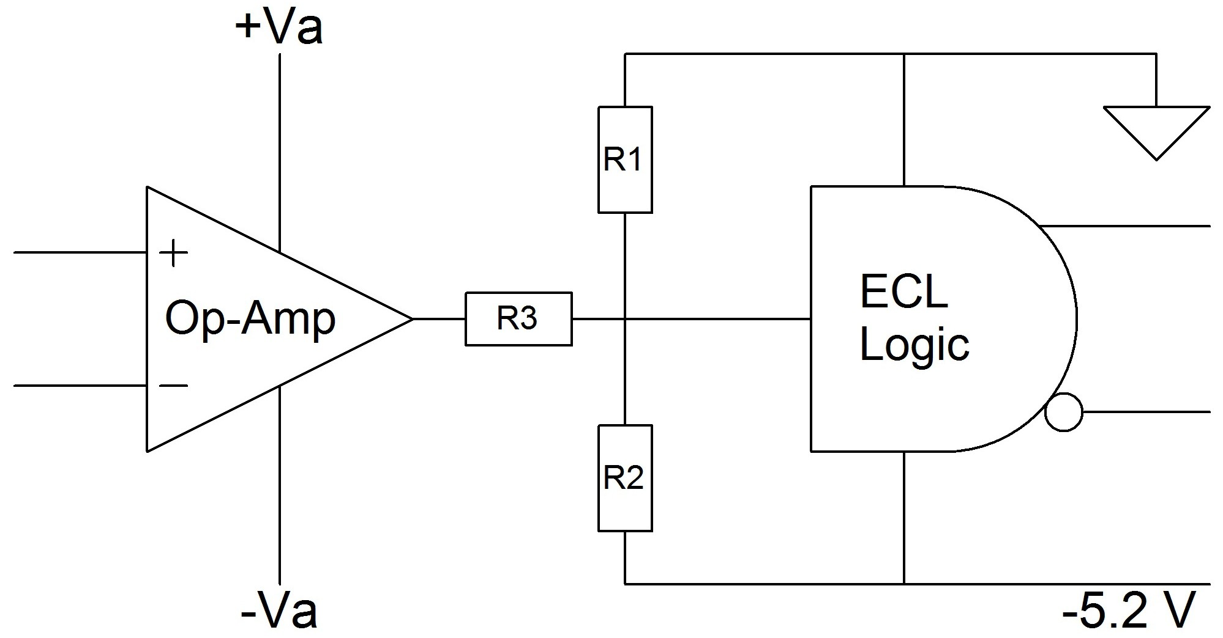
Using Op Amps as Comparators
An ECL interface requires just three resistors
Notes:
We have already pointed out that when op amps are used as comparators they tend to respond more slowly than we might expect, due to saturation. For this reason it is unlikely that there are many applications where op amps, used as comparators, are required to drive emitter coupled logic (ECL) which is, after all, used where the highest logic speeds are required.
But for the sake of completeness let us show the interface in the diagram, which uses just three resistors. R₁, R₂ and R₃ are chosen so that when the op amp output is at its positive limit the level at the ECL gate input is –0.8 V and when it is at its negative limit the voltage is –1.6 V. The ratio of R₁, R₂ and R₃ is set by this requirement – the absolute values are a compromise between speed and power economy.

Slide 13
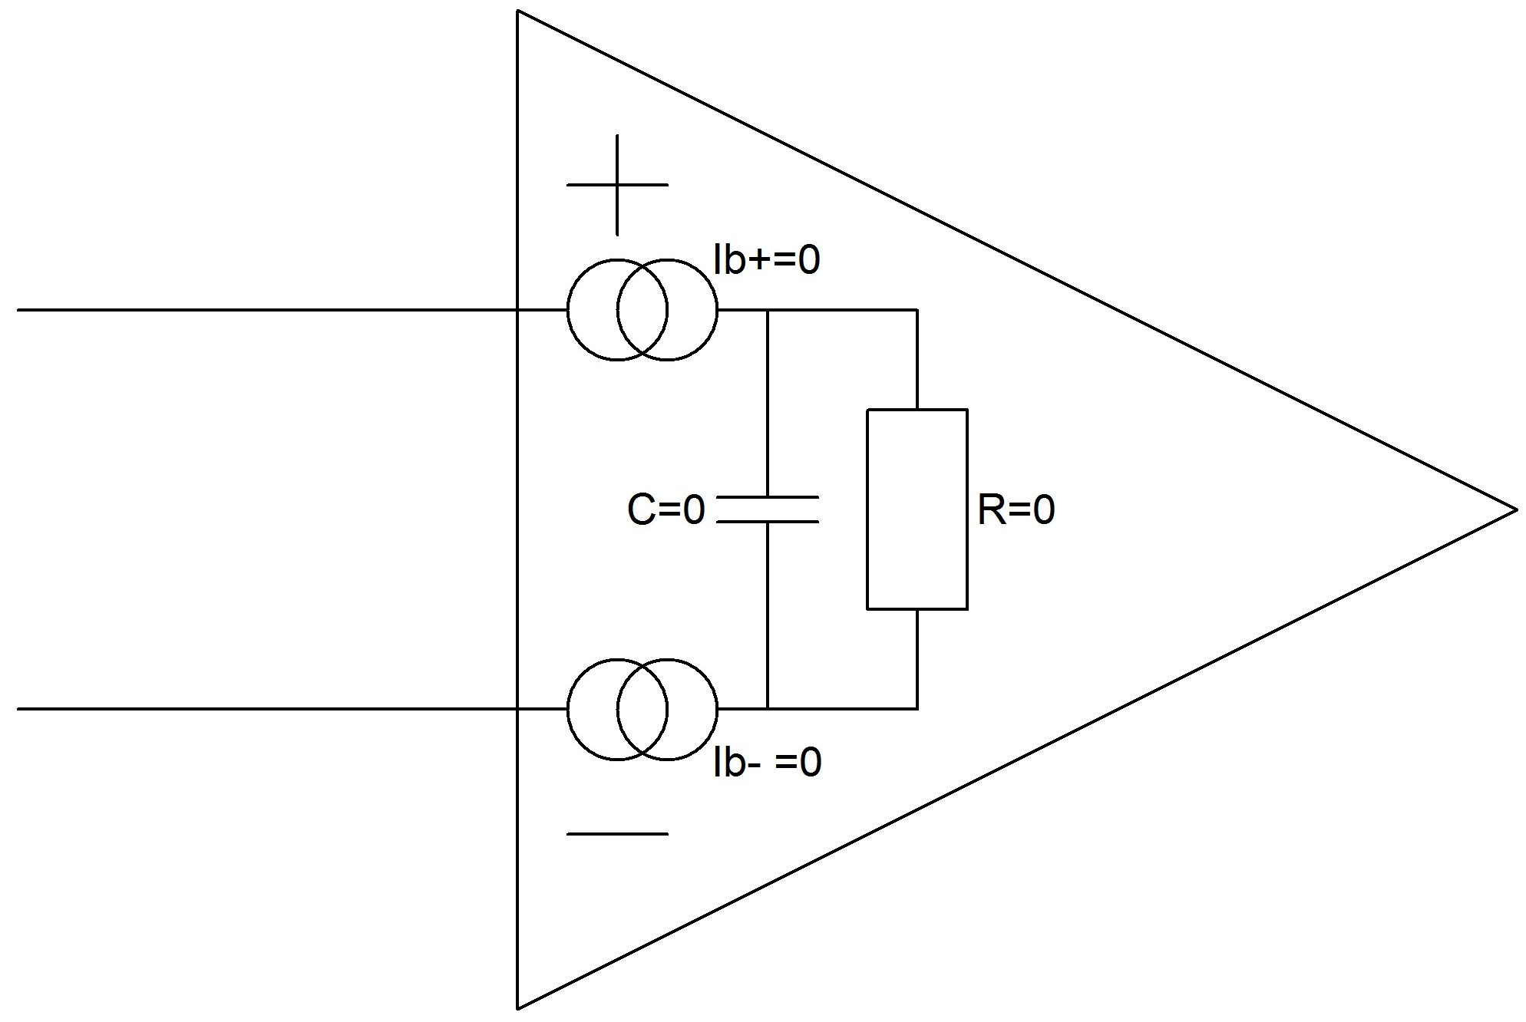
Using Op Amps as Comparators
An ideal op amp
has infinite Z_{in} and
zero bias current
Real life is not so pretty
Notes:
There are a number of issues to be considered concerning the inputs of op amps used as comparators. The first-level assumption is that the input impedance of an op amp is infinite, and while this is a reasonable starting position with voltage-feedback op amps it cannot be held throughout the design process.

Slide 14
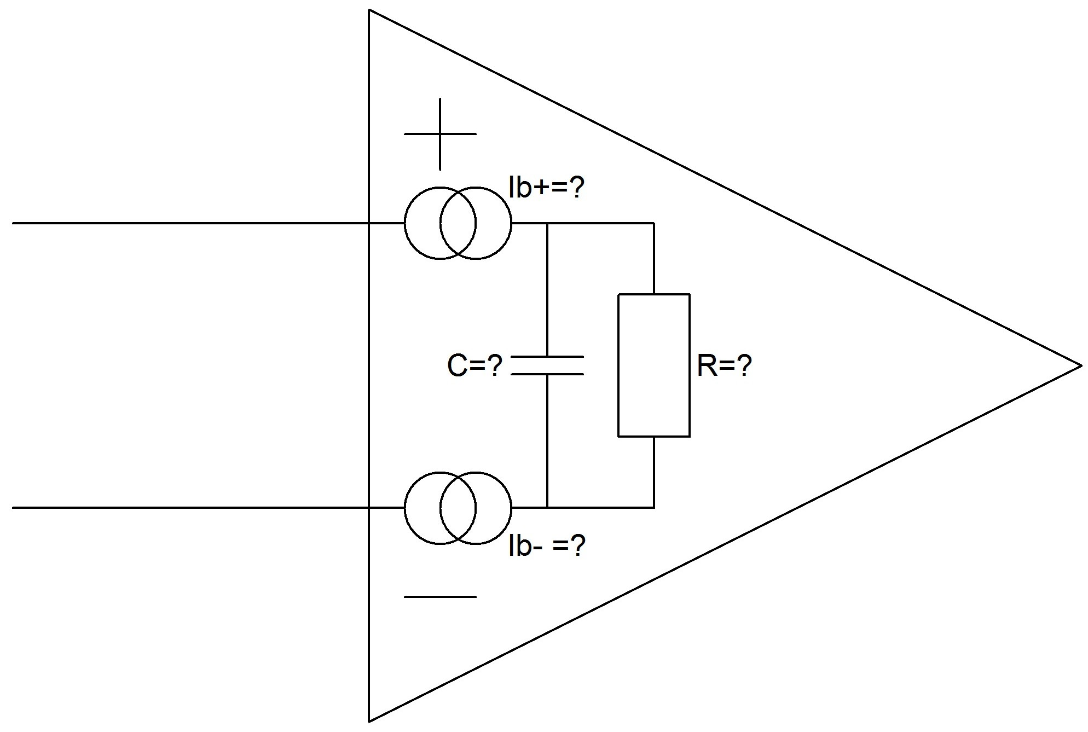
Using Op Amps as Comparators
An ideal op amp
has infinite Z_{in} and
zero bias current
Real life is not so pretty
Except with current-feedback op amps (which have asymmetric input structures and should not be used as comparators) it is reasonable to assume that C and I_{b} are small and R is large
But designs must consider the effects of the actual values
Notes:
It is invalid with current-feedback or “transimpedance” op amps which have a very low impedance at their inverting inputs – for this reason, and others, they should never be used as comparators.
Sooner rather than later we must consider the nature of the actual input impedance and the bias currents. Since with most op amps the impedance is high and the bias currents are low there is usually little difficulty in ensuring that a design will work with the actual range of expected values rather than zero and infinity – but the calculations must be made.
Murphy’s Law, when reduced to its essentials, states that the calculations you do not make are the ones that turn out to have been critical.

Slide 15
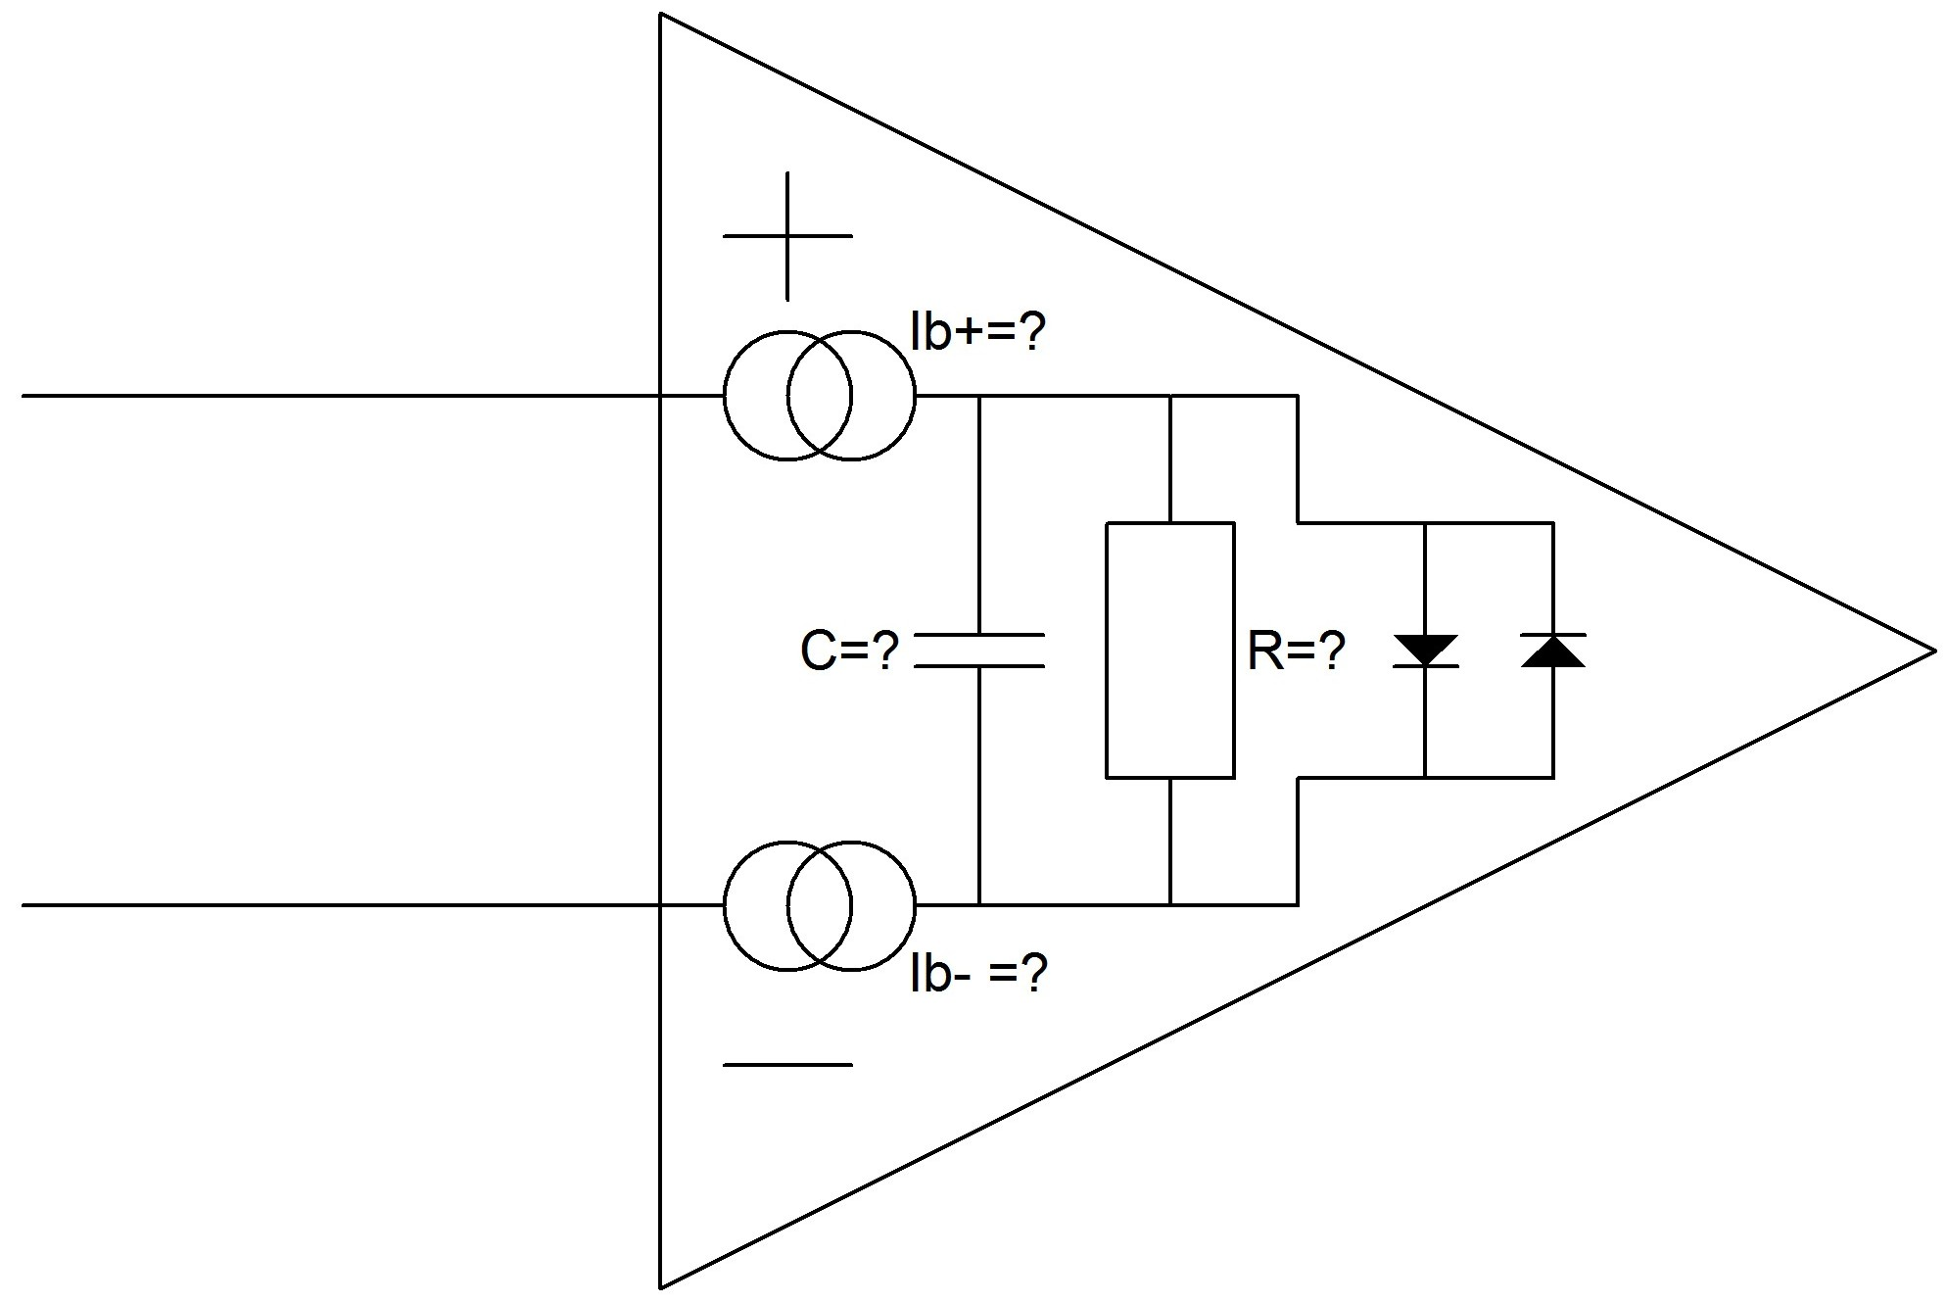
Using Op Amps as Comparators
An ideal op amp
has infinite Z_{in} and
zero bias current
Real life is not so pretty
Except with current-feedback op amps (which have asymmetric input structures and should not be used as comparators) it is reasonable to assume that C and I_{b} are small and R is large
But designs must consider the effects of the actual values
And of any nonlinearities
Notes:
Some op amps have input stages consisting of a so-called “long-tailed pair” of transistors or FETs. These have high input impedance even when a large differential voltage is present between the inverting and non-inverting inputs.
But most modern op amps have more complex input structures, such as bias compensation or rail-to-rail input stages – the latter consisting of two input stages in parallel to allow the common-mode range to include both supplies.
Op amps, as we have already pointed out, are designed to operate with negative feedback which minimizes their differential input, and the complex structures may not respond well to large differential input voltages. It is not practical to discuss all possible architectures in a short lecture, but the protection circuitry shown in the diagram illustrates one of many such structures. With differential inputs below ±0.6 V or so the device has a high input impedance – but above that the protection diodes conduct and the differential input impedance drops abruptly.
In many comparator applications the differential input is limited to a few tens or hundreds of millivolts – but in many it is not, and these effects become important.

Slide 16
Using Op Amps as Comparators
RTFDS
(Read The Friendly Data Sheet)
Determine if nonlinearities in your op amp’s input
will affect its operation as a comparator
LOOK FOR
Low values of absolute maximum differential input voltage
Graphs of bias current vs. differential or common-mode input voltage
(and especially graphs with discontinuities or gross nonlinearities)
Any other input specification or graph which may indicate nonlinearities
WILL YOUR PROPOSED APPLICATION WORK
WITH A COMPARATOR WHICH BEHAVES IN THIS WAY?
Notes:
It is necessary to read the data sheet very carefully to determine if the worst-case voltages expected in the comparator application will affect the op amp performance sufficiently to prevent proper operation.
The reading of data sheets is an art – an art I have no time to discuss in detail here*. But in the present case it is important to look for low values of absolute maximum differential input voltage, for graphs of bias current or input current vs differential or common-mode voltage which show discontinuities or gross non-linearity, and for evidence of phase-inversion (which I shall discuss later).
If any of these are present it is essential to analyse the behaviour of your system to determine if they will prevent it from working properly. This may be done by a simulation, but do note that Spice and other models do not always map well to device behaviour under conditions of large differential input, and it may well be better to do simple pen and paper calculations of the effects to be expected, followed by some experiments.
*My article on reading data sheets can be accessed at this link: http://www.analog.com/analog_root/static/raq/raq_caveat.html

Slide 17
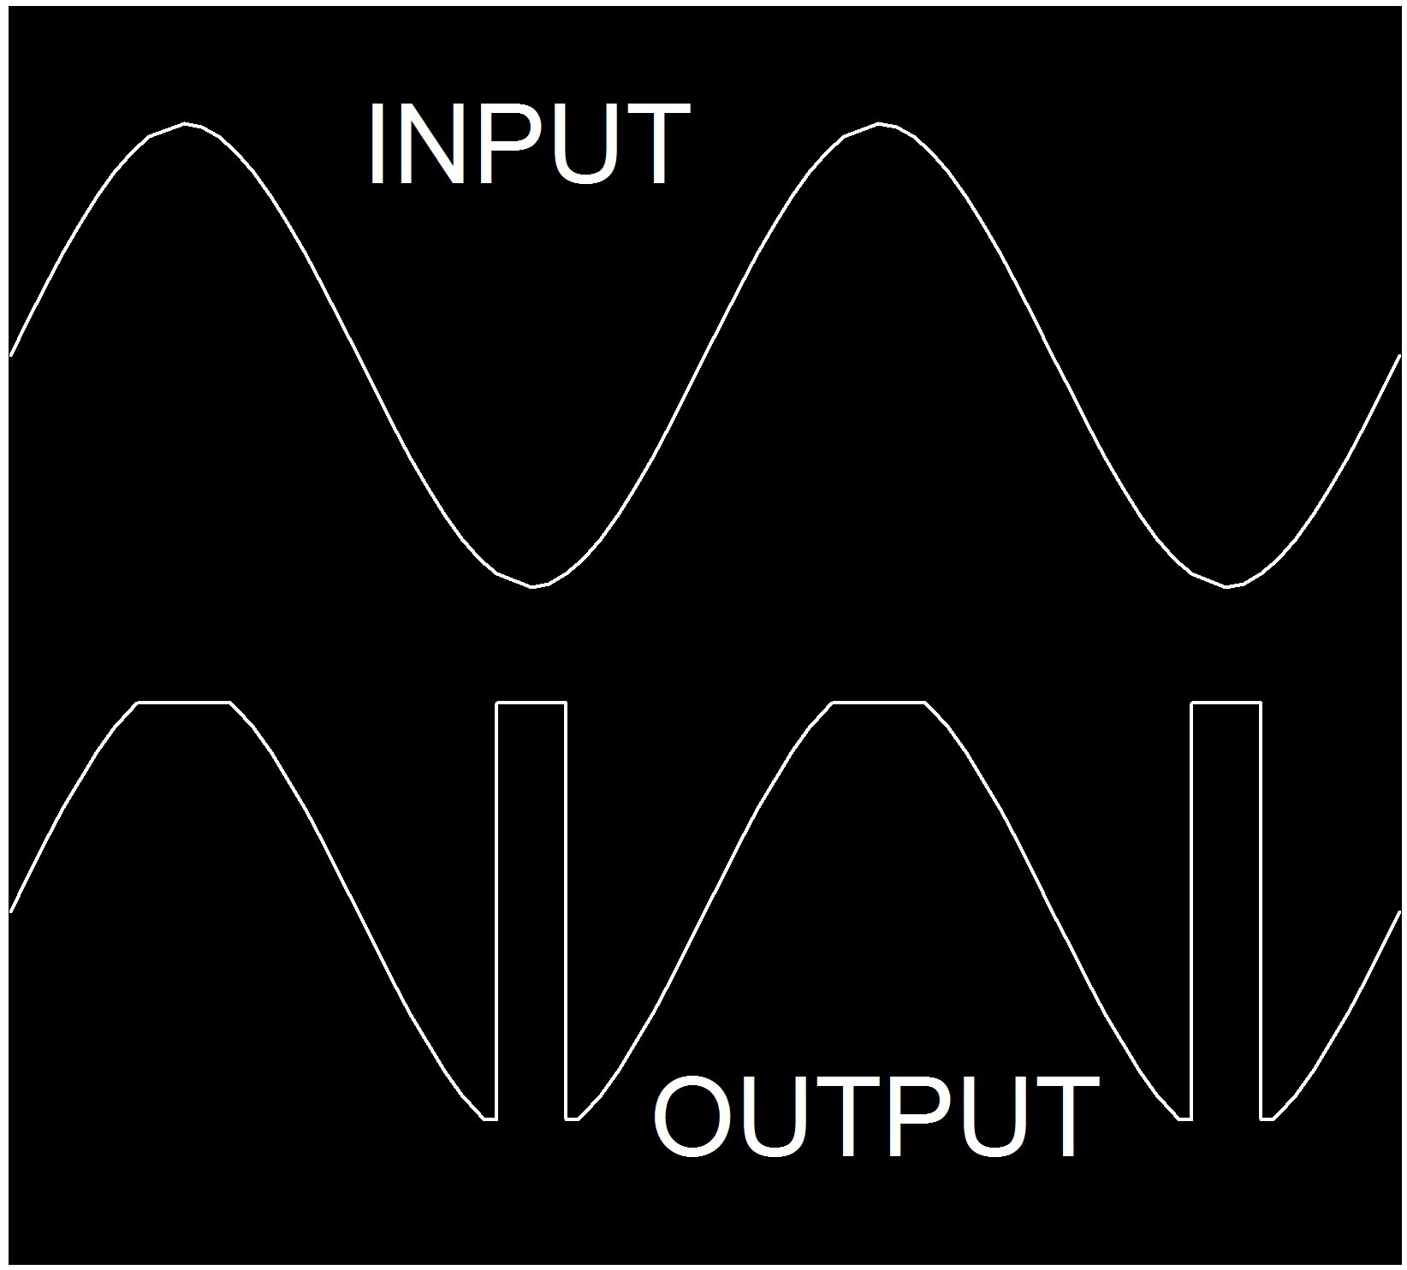
Using Op Amps as Comparators
PHASE INVERSION
Some older types of FET op amp and even a few bipolar types
suffered from a phenomenon called phase inversion
or phase reversal
If the common-mode voltage went outside certain limits
the inverting and non-inverting inputs became interchanged
This effect would be devastating in a comparator and it
Is important to ensure than any op amp used as a comparator
is either free from phase inversion or that it will never be used
with a common-mode voltage which causes phase inversion
Notes:
Older FET input op amps, and even some bipolar types, suffered from a phenomenon call “phase inversion” or “phase reversal”. If the input went outside the allowed common-mode range the inverting and non-inverting inputs exchanged functions.
As can well be imagined, this is embarrassing in a comparator and it is important to ensure that any op amp used as a comparator is either free from phase inversion (most op amps designed in the last five years are) or that the system is designed so that the comparator inputs never approach the region where phase inversion can take place.
Since op amp manufacturers are not proud of phase inversion they do not advertise it in bold letters on the front page of their data sheets. It tends to be mentioned as a limit to the common-mode range in the data tables – without any details of what may happen if you exceed the limit – and, perhaps, a few words in small print at the bottom of page 23. So watch out for it, and if you suspect an op amp suffers from the phenomenon - test it.

Slide 18
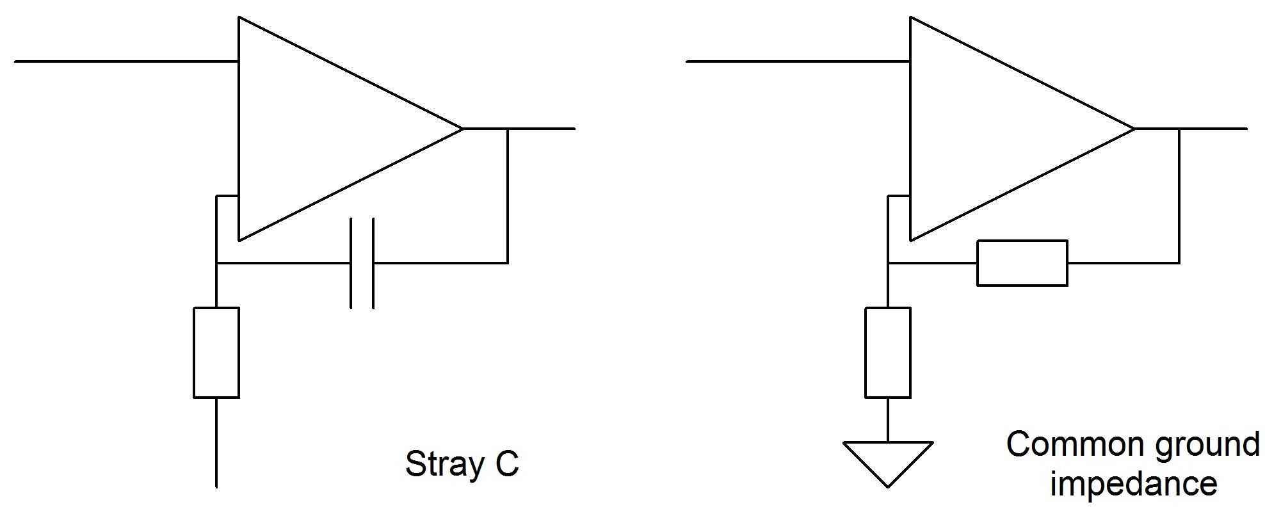
Using Op Amps as Comparators
INSTABILITY
Op amps used as comparators are working at their full open-loop gain and may suffer instability or latch-up due to feedback from stray capacity
or due to common ground impedances
Notes:
An op amp used as a comparator has no negative feedback, and hence very high open-loop gain. During transitions very small amounts of positive feedback can start oscillation.
The feedback can arise from stray capacitance between the output and the non-inverting input, or from output currents flowing in a common ground impedance.
The cure for the first is to minimize stray capacitance by proper layout, and to ensure that the impedance seen by the non-inverting input is as low as possible to attenuate any residual capacitive feedback. Capacitive feedback to the inverting input is only a problem with current feedback op amps (which we have already advised you not to use in this application) and voltage feedback op amps which are not fully compensated (i.e. not unity gain stable).
Ground current feedback is controlled by intelligent design of ground circuit layout. This is discussed in a number of Analog Devices Application Notes that are linked on this web site.

Slide 19
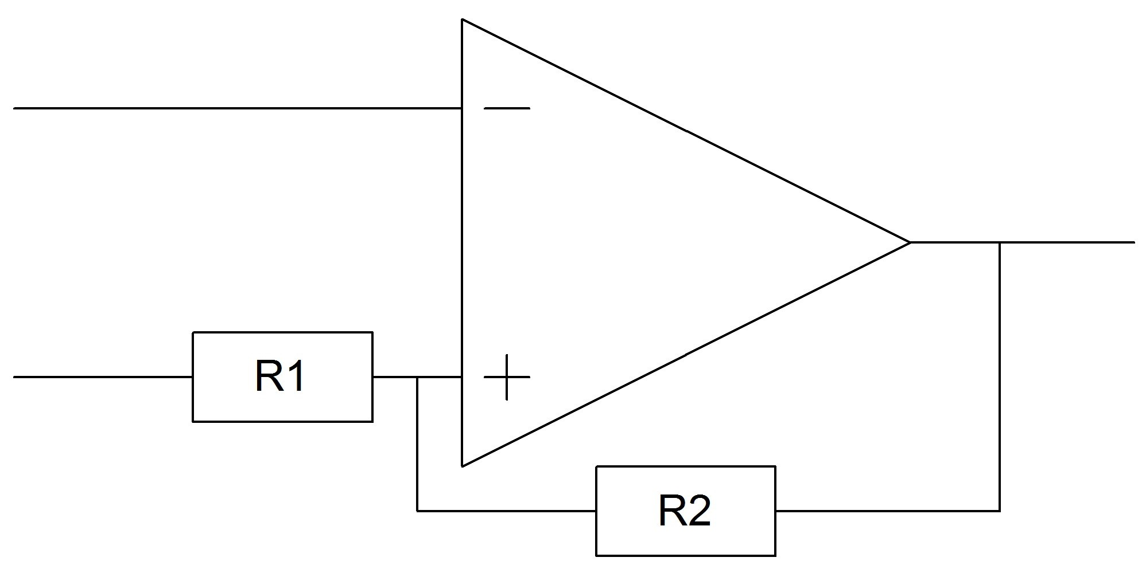

Using Op Amps as Comparators
HYSTERESIS
Using controlled positive feedback to produce hysteresis
can reduce the risk of oscillation
The amount of hysteresis is predictable and is controlled
by the ratio of the positive feedback resistors
Output Swing: V_{s}
Hysteresis
Signal applied to R₁ must come from a source impedance which is much lower than R₁
Notes:
Sometimes it is not possible to prevent instability by these measures. The only remaining possibility is to use a small amount of controlled positive feedback to produce hysteresis so that once a transition has started the input must undergo significant reversal before the reverse transition can occur.
This can be done with two resistors - the amount of hysteresis is proportional to their ratio. The signal input to the comparator may be applied to either the inverting or the non-inverting input, but if it is applied to the non-inverting input the source impedance must be low enough to have an insignificant effect on R₁. Of course if the source impedance is predictable enough it may be used as R₁.

Slide 20


Using Op Amps as Comparators
HYSTERESIS
Calculation of thresholds when the reference
is not midway between the supplies
Comparator output voltages are V_{p} & V_{n}
Reference voltage is V_{r}
Positive threshold is
Negative threshold is
Notes:
If the reference voltage is midway between the two comparator output voltages, as is the case with a symmetrical power supply and a ground reference, then the introduction of hysteresis will move the positive and negative thresholds equal distances from the reference, but if the reference is nearer to one output than to the other then the thresholds will be asymmetrically placed about the reference voltage. This slide shows the calculation of the values of the two thresholds.

Slide 21
Using Op Amps as Comparators
CONCLUSION
OP AMPS MAY BE USED AS COMPARATORS
BUT BE CAREFUL!
Read The Friendly Data Sheet (RTFDS)
Calculate the effects of non-ideal parameters
Experiment
Always interpret your results a little pessimistically
Notes:
In conclusion, although op amps are not designed to be used as comparators, and this lecture has been, intentionally, a little discouraging, there are, nevertheless, many applications where the use of an op amp as comparator is a proper engineering decision.
What is important is to make it a considered decision and to ensure that the op amp chosen will perform as expected.
To do this it is necessary to read the data sheet carefully and to consider the effects of non-ideal op amp parameters on the application. Since the op amp is being used in a non-standard manner some experiment is advisable, and since not all devices are “typical” in their behaviour some pessimism is warranted when interpreting the experimental results.

